Slide 1
Computer Networks EDA387/DIT663
CHALMERS and University of Technology
Computer Science and Engineering Networks and Systems
Fault-tolerant Algorithms for Computer Networks
Convergence in the Presence of Faults (Ch. 6)

Slide 2
Today
We focus on the integration of self stabilization and other fault models, such as crash failures, that can occur during the system execution and not only before the first configuration.

Slide 3
Chapter 6: roadmap
6.1 Digital Clock Synchronization
6.2 Stabilization in Spite of Napping

Slide 4
Digital Clock Synchronization - Motivation
Multi processor computers
Synchronization is needed for coordination – clocks
Global clock pulse & global clock value
Global clock pulse & individual clock values
Individual clock pulse & individual clock values
Fault tolerant clock synchronization
Notes:
Multi processor computers
Have potential to be resilient to faults
Faults # grows with the # of processors
Fault-tolerance is vitally important
Synchronization is needed for coordination – clocks
Global clock pulse & global clock value
Global clock pulse & individual clock values
Individual clock pulse & individual clock values
Fault tolerant clock synchronization

Slide 5
Digital Clock Synchronization
In every pulse each processor reads the value of it’s neighbors clocks and uses these values to calculate its new clock value .
The Goal (1) identical clock values (2) the clock values are incremented by one in every pulse
Notes:
The problem is defined for a system of n identical processors connected to a global common clock pulse. Each processor maintains a digital clock value. In every pulse each processor executes a step in which it reads the value of it’s neighbors’ clocks and uses these values to calculate its new clock value .

Slide 6
Digital Clock Sync – Unbounded version
01 upon a pulse
02 forall P_{j} ∈ N(i) do send (j,clock_{i})
03 max := clock_{i}
04 forall P_{j} ∈ N(i) do
05 receive(clock_{j})
06 if clock_{j} > max then max := clock_{j}
07 od
08 clock_{i} := max + 1
A simple induction can prove that this version of the algorithm is correct:
If P_{m} holds the max clock value, by the i’th pulse every processor of distance i from P_{m} holds the maximal clock value

Slide 7
Digital Clock Synchronization – Bounded version
Unbounded clocks is a drawback in self-stabilizing systems
The use of 2⁶⁴ possible values does not help creating the illusion of “unbounded”:
A single transient fault may cause the clock to reach the maximal clock value …

Slide 8
Digital Clock Sync – Bounded version (max)
Converge-to-the-max
01 upon a pulse
02 forall P_{j} ∈ N(i) do send (j, clock_{i})
03 max := clock_{i}
04 forall P_{j} ∈ N(i) do
05 receive(clock_{j})
06 if clock_{j} > max then max := clock_{j}
07 od
08 clock_{i} := (max + 1) mod ((n +1)d +1)
The Boundary M = ((n+1)d+1);
Where n:# processors, d: diameter of the system.
Why is this algorithm correct?
The number of different clock values can only decrease, and is reduced to a single clock value
Notes:
Note that for ease of description the values we choose for M are not the minimal possible value
The number of clock values can only decrease, and is reduced to a single clock value

Slide 9
For Example:
0
1
M = ((n+1)d+1) = 4*2+1 = 9
8
p3
p1
7
2
Pulse
Round 1
Round 2
Pulse
Round 3
p1
p3
6
p2
3
p2
5
4
3
4
5
6
1
8
0
1
6
5
5
4
6
3
8
0

Slide 10
Digital Clock Sync – Bounded version (max)
Why is this algorithm correct?
If all the clock values are less than M-d we achieve sync before the modulo operation is applied
0
0
1
m-1
1
m-1
.
.
m-2
2
2
After d pulses there must be convergence and the max value is less than m
.
m-i
3
3
m-d
m-d
.
.
.
.
.
m-d-i
.
.
.
Notes:
Note that for ease of description the values we choose for M are not the minimal possible value

Slide 11
Digital Clock Sync – Bounded version (max)
… Why is this algorithm correct?
If not all the clock values are less than M-d
By the pigeonhole principle, in any configuration there must be 2 clock values x and y, such that y-x ≥ d+1, and there is no other clock value between
After i steps, no clock value that is in (x+i, y+i)
After M-y+1 pulses the system reaches a configuration in which all clock values are less than M-d
Notes:
Note that for ease of description the values we choose for M are not the minimal possible value

Slide 12
Digital Clock Sync – Bounded version (min)
The Boundary M = 2d+1
Why is this algorithm correct?
If no processor assigns 0 during the first d pulses – sync is achieved (can be shown by simple induction)
Else
A processor assigns 0 during the first d pulses,
d pulses after this point a configuration c is reached such that
there is no clock value greater than d: the first case holds
01 upon a pulse
02 forall P_{j} ∈ N(i) do send (j,clock_{i})
03 min := clock_{i}
04 forall P_{j} ∈ N(i) do
05 receive(clock_{j})
06 if clock_{j} < min then min := clock_{j}
07 od
08 clock_{i} := (min + 1) mod (2d +1)

Slide 13
Digital clocks with a constant number of states are impossible
Consider only deterministic algorithm:
There is no uniform digital clock-synchronization algorithm that uses only a constant number of states per processor.
Notes:
One may wonder whether the number of clock values be further reduced. Can this number be a fixed constant that is related to neither the diameter of the system nor the number of processors in the system? The following elegant lower bound on the number of states per processor proves that there is no uniform digital clock-synchronization algorithm that uses only a constant number of states per processor. To prove the lower bound, we restrict our attention to systems with ring communication graphs. This is a special case of general communication graph systems; therefore, a lower bound for this special case implies a lower bound for the general communication graph case.

Slide 14
Digital clocks with a constant number of states are impossible
A special case will imply a lower bound for the general case
A processor can read only the clock of a subset of its neighbors
In a undirected ring every processor has a left and right neighbor, and can read the state of its left neighbor
s_{i}^{t+1}= f(s_{i-1}^{t}, s_{i}^{t}) s_{i}^{t} - state of P_{i} in time t, f - the transition function
|S| - the constant number of states of a processor
Notes:
The proof shows that a configuration exists for a sufficiently large ring such that the states of the processor rotate: in every step, the state of every processor is changed to the state of its right processor
To present the main ideas of the lower bound, we start in a restricted case in which a processor can read only the clock of a subset of its neighbors, and we prove a lower bound for a unidirected ring. In a unidirected ring every processor has a left and a right neighbor. The left and right neighbor relation is global in the following sense: if Pi is the left neighbor of Pj then Pj is the right neighbor of Pi. In a unidirected ring a processor can read the state of its left neighbor. Given any self-stabilizing digital clock-synchronization algorithm for a unidirected ring, denote the transition function of every processor by . Each transition is denoted by * +1 f(s i_l, sj), where sj and s _l are the states of Pi and its left neighbor, respectively, at time t, and sj+l is the state of P, at time t + 1. Assume that the number of states of every processor is a constant; in other words, the number of possible states is not a function of the number of the processors in the ring. Let |S| be the constant number of states of a processor. The idea is to choose a sufficiently large ring for which the given algorithm will never stabilize. The proof shows that a configuration exists for a sufficiently large ring such that the states of the processors rotate: in every step, the state of every processor is changed to the state of its right processor.

Slide 15
Digital clocks with a constant number of states are impossible
The idea is to choose a sufficiently large ring for which the given algorithm will never stabilize.
The proof shows that a configuration exists for a sufficiently large ring such that the states of the processors rotate:
in every step, the state of every processor is changed to the state of its right processor.
Notes:
The proof shows that a configuration exists for a sufficiently large ring such that the states of the processor rotate: in every step, the state of every processor is changed to the state of its right processor
To present the main ideas of the lower bound, we start in a restricted case in which a processor can read only the clock of a subset of its neighbors, and we prove a lower bound for a unidirected ring. In a unidirected ring every processor has a left and a right neighbor. The left and right neighbor relation is global in the following sense: if Pi is the left neighbor of Pj then Pj is the right neighbor of Pi. In a unidirected ring a processor can read the state of its left neighbor. Given any self-stabilizing digital clock-synchronization algorithm for a unidirected ring, denote the transition function of every processor by . Each transition is denoted by * +1 f(s i_l, sj), where sj and s _l are the states of Pi and its left neighbor, respectively, at time t, and sj+l is the state of P, at time t + 1. Assume that the number of states of every processor is a constant; in other words, the number of possible states is not a function of the number of the processors in the ring. Let |S| be the constant number of states of a processor. The idea is to choose a sufficiently large ring for which the given algorithm will never stabilize. The proof shows that a configuration exists for a sufficiently large ring such that the states of the processors rotate: in every step, the state of every processor is changed to the state of its right processor.

Slide 16
Digital clocks with a constant number of states are impossible
s₁
s₂
s₃ = f(s₁, s₂)
s_{l+2} = f(s_{l}, s_{l+1})
. . .
. . .
. . .
s_{j}
s_{j}
s_{k}
s_{j+1}
s_{k}
s_{j}
s_{j+1}
There must be a sequence of states s_{j},s_{j+1},…, s_{k-1},s_{k} that is, a subset of this infinite sequence such that f(s_{k-1},s_{k}) = s_{j} and f(s_{k},s_{j}) = s_{j+1}
s_{k+2} = s_{j+1}
s_{k+1} = s_{j}
s_{k+2} = s_{j+1}
s_{k}
s_{k+1} = s_{j}
s_{j}
s_{k}
s_{j}
s_{j+1}
Use s₁ and s₂ to construct an infinite sequence of states such that s_{i+2} = f(s_{i},s_{i+1})
s_{j}
s_{j+1}
s_{j+1}
. . .
. . .
. . .
. . .
. . .
. . .
. . .
s_{j+1}
. . .
Pulse
. . .
s_{k-1}
. . .
s_{k-1}
. . .
. . .
s_{k+2} = s_{j+1}
. . .
. . .
. . .
. . .
. . .
. . .
In each pulse, the states are rotated one place to the left.
s_{k}
s_{k+1} = s_{j}
s_{k-1}
s_{k+2} = s_{j+1}
s_{k+1} = s_{j}
s_{k}

Slide 17
Digital clocks with a constant number of states are impossible
Since the states of the processors encodes the clock values, and the set of states just rotates around the ring,
It has to be the case in which all the states encode the same clock value. (the clock is constant which is not possible, and the stat of processor is just rotating).
On the other hand, the clock value must be increments in every pulse.
Contradiction.
Do we have to assume that the ring is unidirectional?
Does a probabilistic algorithm exists for this ring?

Slide 18
Digital clocks with a constant number of states are impossible
Let s₁ and s₂ be two states in S;
e.g., the first two states according to some arbitrary state ordering
Use s₁ and s₂ to construct an infinite sequence of states such that s_{l+2} = f(s_{l}, s_{l+1}).
There must be a sequence of states s_{j}, s_{j+i}, …, s_{k-1}, s_{k}
that is, a subset of the above infinite sequence
such that f(s_{k-1} ,s_{k}) = s_{j} and f(s_{k},s_{j}) =s_{j+1} and k > j + 2; or, equivalently, s_{k+1}=s_{j} and s_{k+2}=s_{j+1}.

Slide 19
Digital clocks with a constant number of states are impossible
Any sequence of |S|²+1 such pairs has at least one pair (s_{j}, s_{j+1}) that appears more than once.
Thus, any segment of 2(|S|²+1) states in the infinite sequence can be used in our proof.
Now, we are convinced that there is a sequence s_{j}, s_{j+i}, …, s_{k-1}, s_{k} in which the combination s_{k+i}, s_{k+2} and the combination s_{j}, s_{j+i} are identical. Therefore, it holds that f(s_{k-i}, s_{k})=sj and f(s_{k}, s_{j})=s_{j+y}.

Slide 20
Digital clocks with a constant number of states are impossible
Now construct a unidirected ring of processors using the sequence s_{j}, s_{j+i}, …, s_{k-1}, s_{k}, where the processor in state s_{k} is the left neighbor of the processor in state s_{j}.
Each processor uses its own state and the state of its left neighbor to compute the next state;
in accordance with our construction, the state s_{j+i} is changed to s_{j+i+1} for every 0≤i<k-j, and the state s_{k} is changed to s_{j}.
We conclude that, in each pulse, the states are rotated one place to the left.
Note that the above is true in an infinite execution starting in the configuration defined above.

Slide 21
Digital clocks with a constant number of states are impossible
Is it possible that such an infinite execution will converge?
Since the states of the processors encodes the clock value and the set of states is not changed during an infinite execution (it just rotates around the ring), we must assume that all the states encode the same clock value.
On the other hand, the clock value must be incremented in every pulse.

Slide 22
Digital clocks with a constant number of states are impossible
This is impossible, since the set of states is not changed during the infinite execution.
In the more complicated case of bidirectional rings, the lower-bound proof uses a similar approach.
The prove want to the show, the system should have a single clock value to converge, or it will not rich the single clock value which the system will not converge.

Slide 23
Chapter 6: roadmap
6.1 Digital Clock Synchronization
6.2 Stabilization in Spite of Napping

Slide 24
Stabilizing in Spite of Napping
Wait-free self-stabilizing clock-synchronization algorithm is a clock-sync. algorithm that copes with transient and napping faults (napping means the processor dose not tack steps, special fault)
Each non-faulty operating processor ignores the faulty processors and increments its clock value by one in every pulse
Given a fixed integer k, once a processor p_{i} works correctly for at least k time units and continues working correctly, the following properties hold:
Adjustment: p_{i} does not adjust its clock
Agreement: p_{i}’s clock agrees with the clock of every other processor that has also been working correctly for at least k time units

Slide 25
Algorithms that fulfill the adjustment-agreement – unbounded clocks
Simple example for k =1, using the unbounded clocks
In every step – each processor reads the clock values of the other processors, and chooses the maximal value (denote by x) and assigns x+1 to its clock
Note that this approach wont work using bounded clock values
P₁
P₁
P₁
P₁
11
10
5
7
5
7
5
7
5
5
0
0
5
The clock value never changes until the napping processor with max value starts to work
5
After an execution of P₁, it’s clock holds the maximal clock value, and wont adjust its clock as long as it doesn’t crash
After an execution of P₁, it’s clock holds the maximal clock value, and wont adjust its clock as long as it doesn’t crash
After an execution of P₁, it’s clock holds the maximal clock value, and wont adjust its clock as long as it doesn’t crash
3
3
3
9
3
9
9
max
9
max
8
max
0
0

Slide 26
Algorithms that fulfill the adjustment-agreement – bounded clock values
Using bounded clock values (M)
The idea – identifying crashed processors and ignoring their values
Each processor P has:
P.clock ∈ {0… M-1}
∀Q P.count[Q] ∈ {0,1,2}
P is behind Q if P.count[Q]+1 (mod 3) = Q.count[P]
P
Q
P.count[Q]
0
1
2
Q.count[P]
1
2
0

Slide 27




Algorithms that fulfill the adjustment-agreement – bounded solution
The implementation is based on the concept of the “rock, paper, scissors” children’s game
1
2
0
>
>
>
2
0
2
1
0
2
VS
VS
VS
VS
VS
VS
1

Slide 28
Algorithms that fulfill the adjustment-agreement – bounded solution
The program for P:
Read every count and clock
Find the processor set R that are not behind any other processor
If R ≠ ∅ then P finds a processor K with the maximal clock value in R and assigns P.clock := K.clock + 1 (mod M)
For every processor Q, if Q is not behind P then P.count[Q] := P.count[Q] + 1 (mod 3)

Slide 29
Self-stabilizing Wait-free Bounded Solution – Run Sample
R
R
R
R
R
P₁
R
P₁
P₂
P₁
P₂
P₁
P₂
P₁
P₂
P₂
5
7
6
8
7
8
4
5
4
5
2
7
2
2
6
2
7
1
1
1
P₃
P₃
P₃
P₃
P₄
P₃
P₄
P₄
P₄
P₄
R
R
R
Active processor
Simple connection
K = 2
“behind” connection

Slide 30
The algorithm is wait-free and self-stabilizing
The algorithm presented is a wait-free self-stabilizing clock-synchronization algorithm with k=2 (Th. 6.1)
All processors that take a step at the same pulse, see the same view
Each processor that executes a single step belongs to R in the next round, in which all the clock values are the same ⇒ the agreement requirement holds
Every processor chooses the maximal clock value of a processor in R, and increments it by 1 mod M ⇒ the adjustment requirement holds
The proof assumes an arbitrary start configuration ⇒ the algorithm is both wait-free and self-stabilizing
Notes:
Assuming P_{i} executes more than k steps: - R is not empty (after P_{i}’s first step) - Following P_{i}’s second step the clock values of the processors that belong to R are the same

Slide 31
Theorem 6.1
Theorem 6.1: The above algorithm is a wait-free self-stabilizing clock-synchronization algorithm with k=2.
Proof
The proof shows that, starting with any values in the order variables and the clock variables, the algorithm meets the adjustment and agreement requirements.

Slide 32
Theorem 6.1 (cont.)
First note that all processors that take a step at the same pulse, see the same view
because they have access to all fields at all registers.
They then compute the same NB (non-blocking processors), which is R is the above code.
We must show that, if any processor p_{i} executes more than k=2 successive steps, then the agreement and adjustment requirements hold following its second step.

Slide 33
Theorem 6.1 (cont.)
Assume p_{i} executes more than k=2 successive steps.
Observe that NB is not empty following p_{i} ’s first step.
Moreover, while p_{i} continues to execute steps without stopping, it remains in NB.
The reason is that p_{i} executes a step in which it increments every order variable order_{ij}, such that p_{j} is not behind p_{i}.

Slide 34
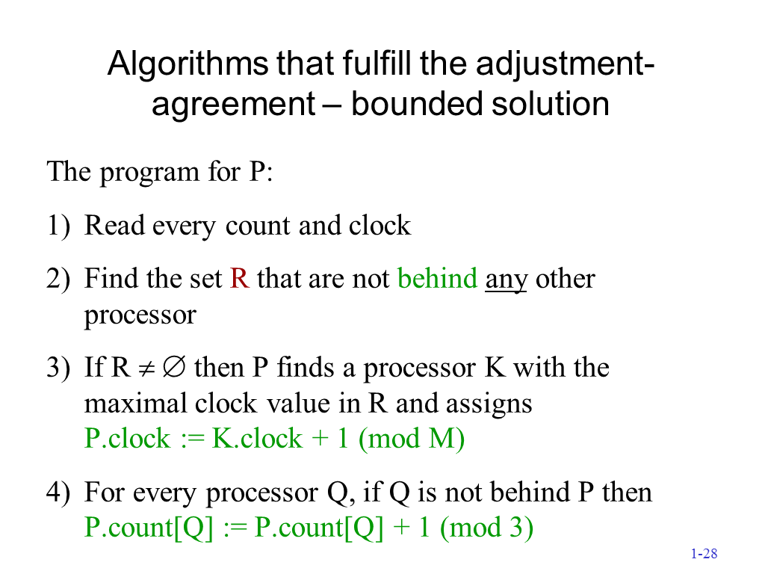

Slide 35
Theorem 6.1 (cont.)
Since NB is not empty following the first step of p_{i}, and since all processors that execute a step see the same set NB, all the processors that execute a step following the first step of p_{i} choose the same clock value.
Thus, following the second step of p_{i} and while p_{i} does not stop executing steps, the clock values of the processors that belong to NB are the same.

Slide 36
Theorem 6.1 (cont.)
Every processor that executes a single step belongs to NB, and the value of the clocks of all processors in NB is the same; thus the agreement requirement holds.
Every processor chooses the maximal clock value m of a processor in NB and increments m by 1 modulo M; thus, the adjustment requirement holds as well.

Slide 37
Theorem 6.1 (cont.)
The proof of the theorem assumes an arbitrary starting configuration for the execution with any combination of order and clock values. Thus our algorithm is both wait-free and self-stabilizing. ■

Slide 38
Summary
We have looked into some common fault models and presented how the task of self-stabilizing clock synchronization can consider them.

Slide 39
Review Questions
Can a smaller number than ((n + 1)d + 1) be used in line 8 of figure 6.2 without changing any other statement in the code? Prove stabilization or present a contradicting example.

Slide 40
Review Questions
Consider digital clock-synchronization algorithms for a line of processors P₁, P₂, …, P_{n}, where P_{i} , 2≤ i ≤n-1, communicates with the processors P_{i-1} and P_{i+1}; similarly, P₁ communicates with P₂ and P_{n} with P_{n-1}. Assume that processors have no sense of direction: the fact that P_{i} considers P_{i-1} its left neighbor does not imply that P_{i-1} considers P_{i} its right neighbor. Will the algorithm presented in figure 6.2 stabilize when the increment operations are modulo 3? Prove your answer or present a contradicting example.

Slide 41
Review Questions
Will the unbounded algorithm that is presented in Figure 6.1 stabilize if the minimal clock value plus one is assigned to clock_{i}? Will it stabilize if the average clock value (counting only the integer part of the average result) is used?

